Slide 1

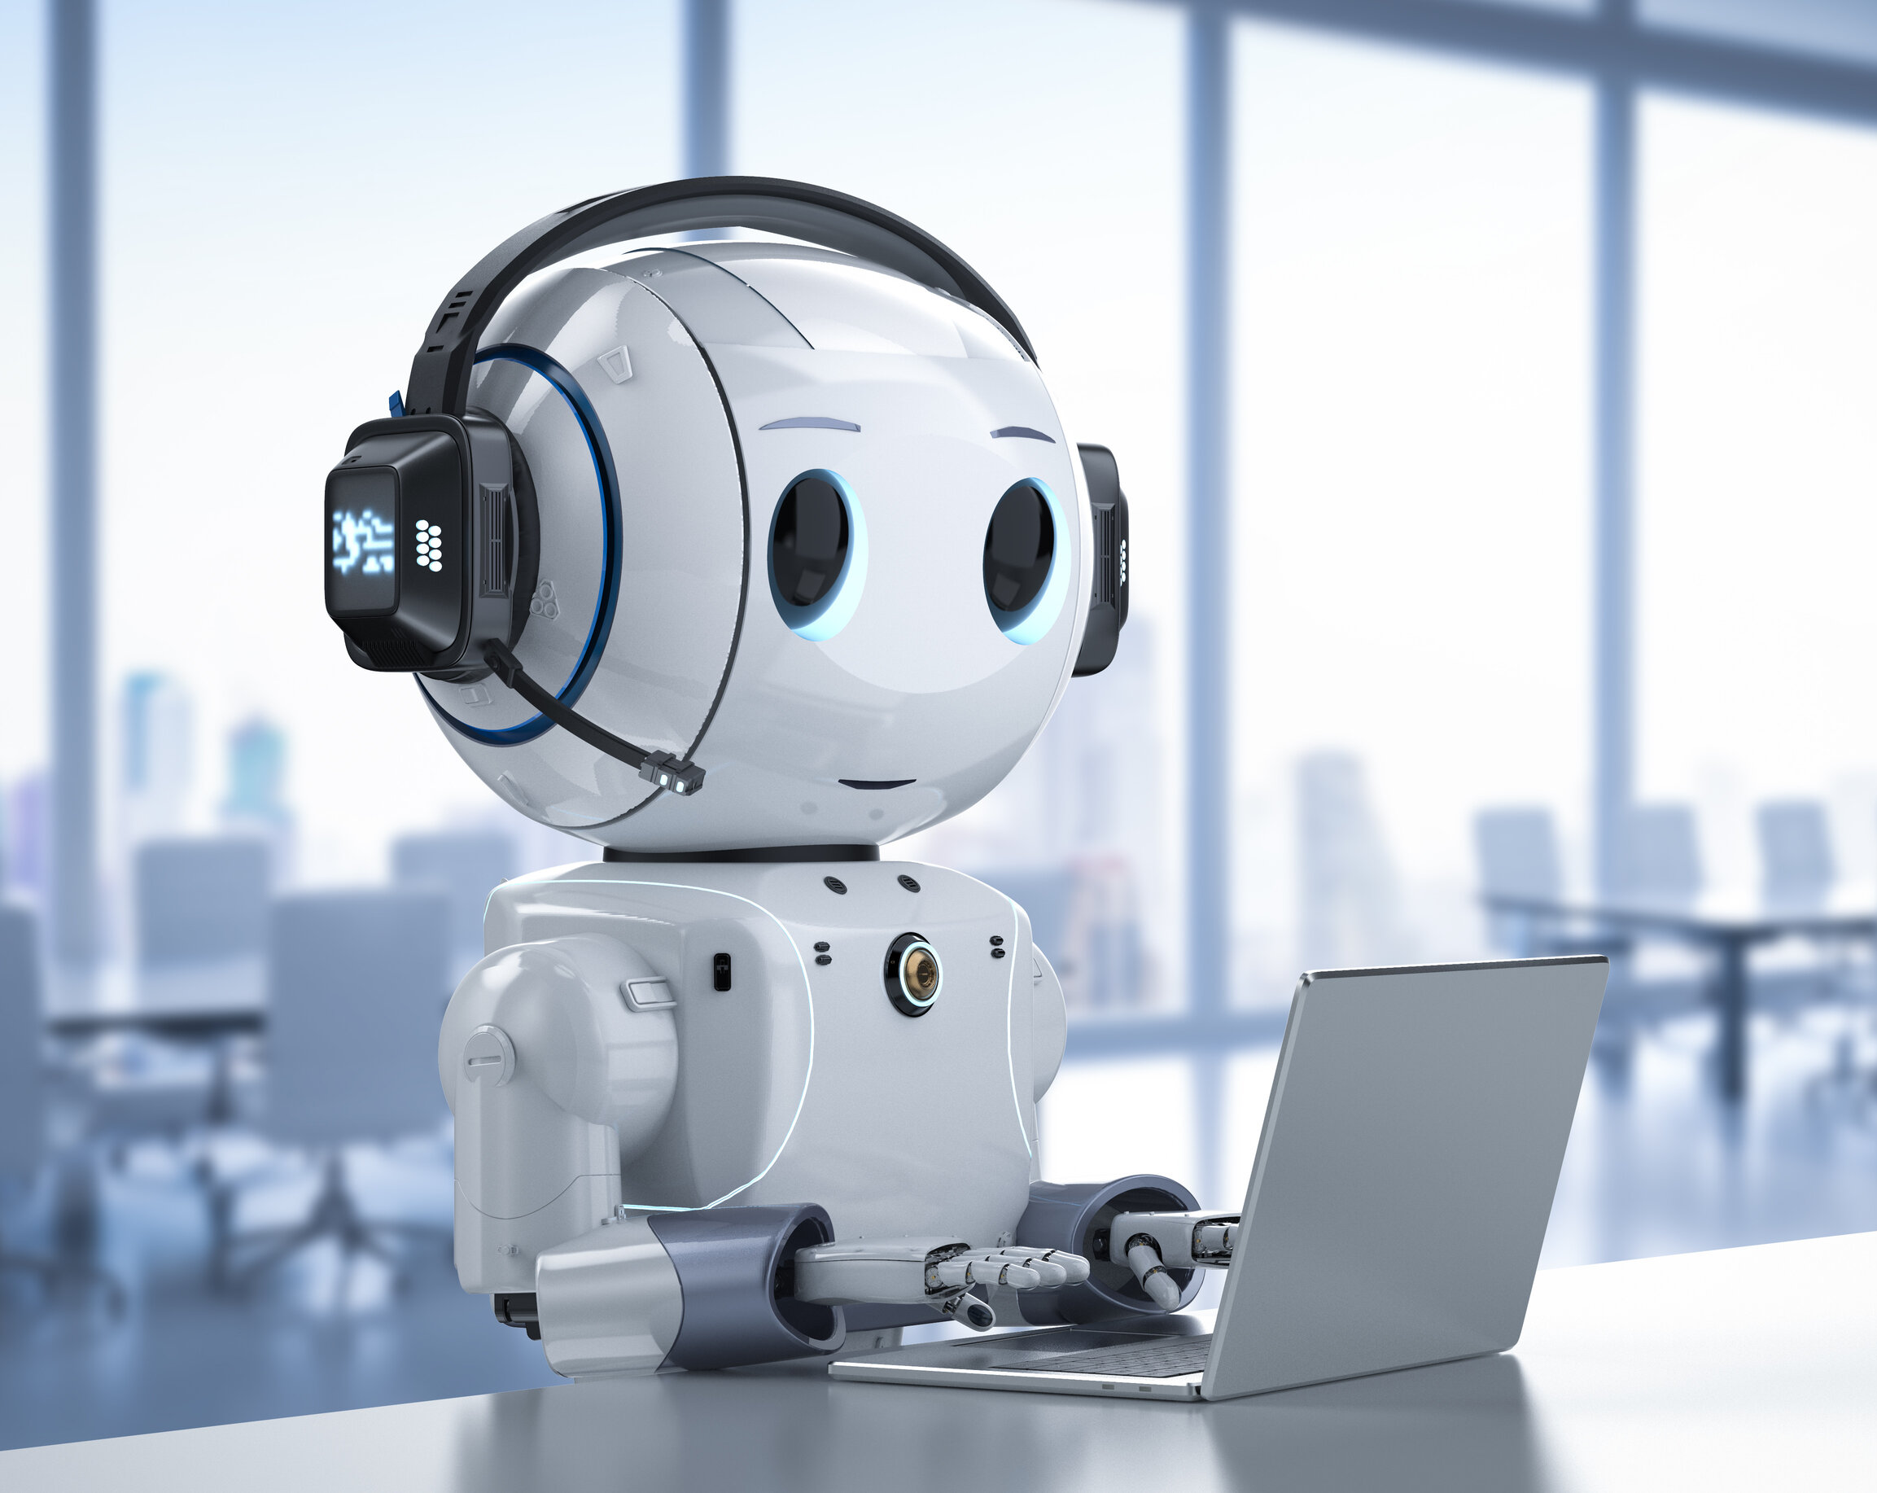
ChatBot (ChatGPT)
Project base learning
FE.Div : D
Submitted By:
Tejas Bhagat
Aditi Latane
Chintamani Adak
Rohit Belhekar
Mayuresh Bhabhale
Under Guidance Of :-
Prof.Sarita Mali

Slide 2

Content
AIM
OBJECTIVE
Introduction
Abstract
ACKNOWLEDGMENT
What IS Chatbot
A image of chatbot how its works
History of chatbot
Merits
demerits

Slide 3
AIM
The main aim of this thesis is to investigate opinions and behaviors, in terms of perceived benefits and drawbacks
Whether or not implementing a chatbot onto a university’s website can be mutually beneficial for both the university to lessen the number of incoming questions and the prospective students in their decision-making process to select their future school.

Slide 4
Chatbots can support students in finding course details quickly by connecting them to key information.
This can alleviate the burden for instructional staff, as the chatbot can serve as the first line of communication regarding due dates, assignment details, homework resources, etc.

Slide 5
OBJECTIVE
To have human-like conversations and much more with the chatbot.
The language model can answer questions and assist you with tasks, such as composing emails, essays, etc
The main objective of our project is to spread awarness about the upcoming technology and take you to the future

Slide 6
INTRODUCTION
This thesis contains the history of the chatbot.
How a chatbot comes into this world, and how they are being used in different institutes and businesses
Discuss the transformation of the chatbot from the beginning till now and how they are being used in today's world.
It also introduces the merits and demerits of the Chatbot/ChatGPT.

Slide 7
abstract
In this project, you will find a comprehensive account of the chatbot's evolution.
From its inception to its current widespread use in various industries , businesses.

Slide 8
The discussion covers the history of chatbot ,their birth and growth and the ways in which they have transformed overtime
Additionally chapter explores the divers applications of chatbots in today's world.

Slide 9
ACKNOWLEDGMENT
We would like to take this opportunity to give a big thank you to everyone who has helped or contributed in one way or another to our thesis. First of all, we would like to thank our thesis supervisor Hon. Sarita Mali Mam for the insightful guidance and input.Further more your positive attitude gave us the motivation to keep us going when it was most needed. We would also like to thank the student teams in our seminar group for providing us with critical Contribution, your input has helped us shape our thesis into what it is today.. This thesis has been one of the most eye-opening adventures for us, and for this, we are truly grateful.

Slide 10
What is chatbot?
The thought behind this technological advancement was to provide users with quick and instantaneous responses to questions that they would ask when conversing through email or by phone
Chatbots has boost productivity among users and lessen the time being spent on tasks.

Slide 11
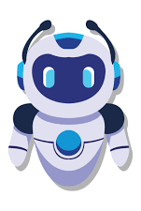
A chatbot is a type of modern computing program that uses textual or vocal interfaces to replicate human communication or "chitchat.”
It is widely used in many large-scale applications.

Slide 12
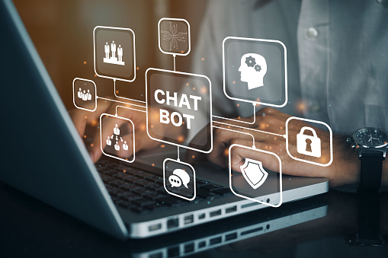

Slide 13
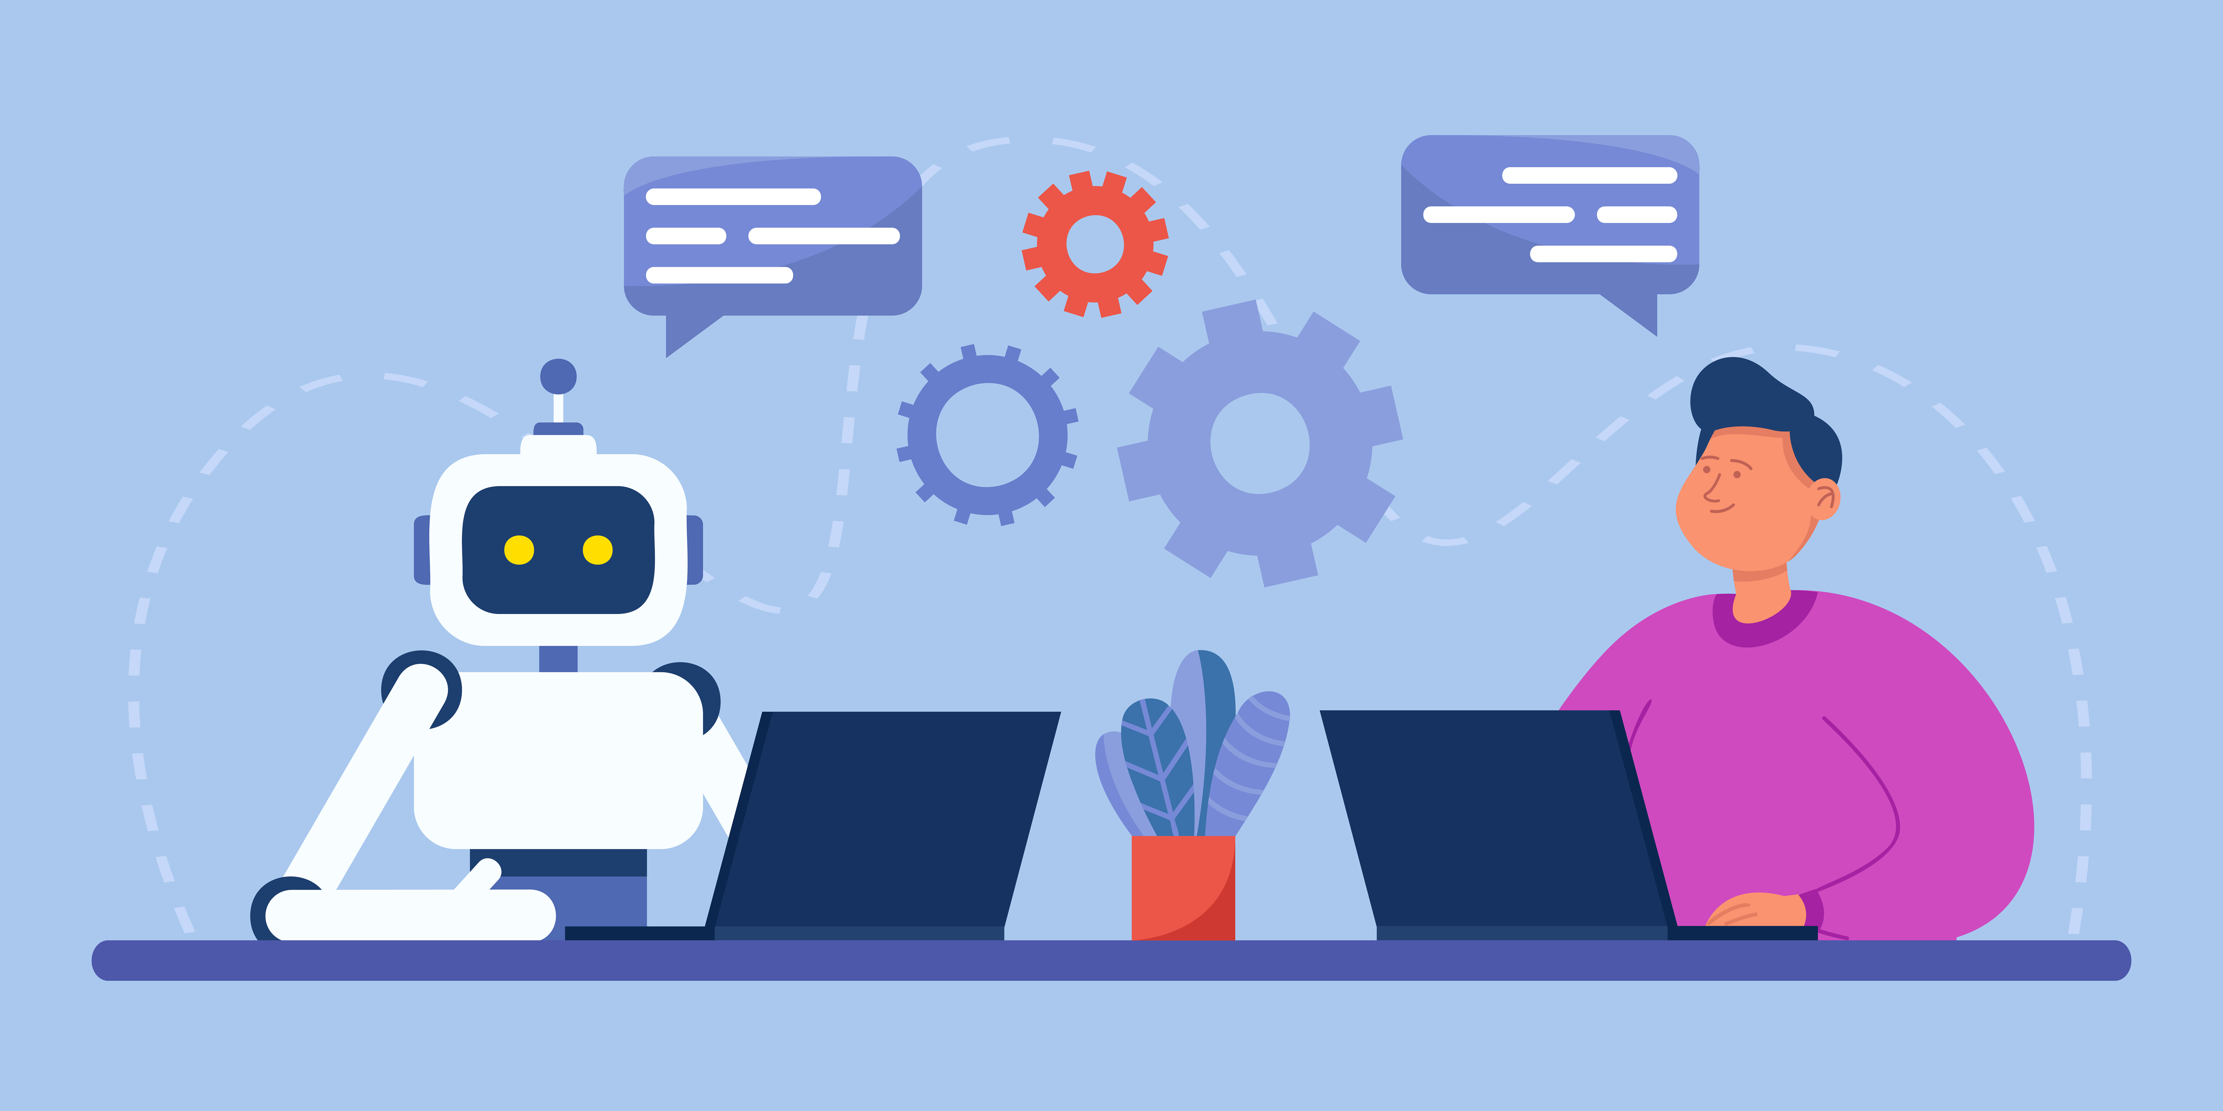
A image of chatbot : how its works

Slide 14
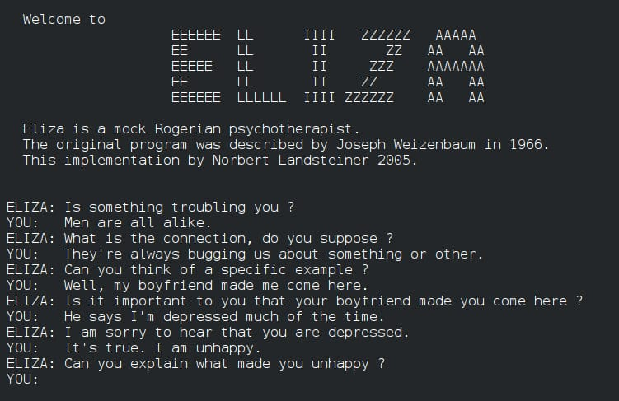
History of chatbot
Eliza is considered as the first chatbot which works on the pattern matching system.
It is developed by Joseph Weizenbaum in 1966
It has more than 40,000 categories, where each category has combination of
They said that chatbots are easy to implement, they are lightweight and efficient to work. Their paper gives the detailed information about the different applications of the chatbots.

Slide 15
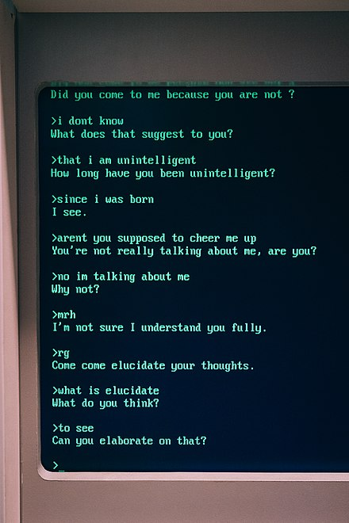
Thomas N. T. and Amrita Vishwa designed a AIML and 1.5A based chatbot to provide the customer care service over the E-commerce websites.
Their approach shows we can improve the chatbot ability by adding other models to it.
In android operating system, we can implement the chatbot using the various approaches.

Slide 16
Merits
Chatbots are cheap, easy and efficient way to communicate with customers.
Chatbots are intelligent. Advanced software learns from past interactions/responses and hence improves responses over time.
Chatbots are effective. It allows users to perform tasks efficiently and accurately.

Slide 17
Chatbots are engaging. It enables human like interaction delivered through a channel that is easily scalable.
It does not require human being for its operation and hence saves cost of hiring human beings. It can be employed as per business model.
As chatbot technology is based on AI, I recommend reader to understand advantages of Artificial Intelligence .

Slide 18
demerits
Chatbots can't answer all the queries and hence it can be seen as lacking personal touch.Certain chatbots are poor in processing and takes time to filter results. This annoys the users.
Different chatbots require different installation procedures and hence increases initial installation cost unlike human beings.Certain chatbots have limited availability of data and require some time for their self update. This process leads to slower response times and expensive solutions.

Slide 19
Chatbots are poor in making decisions unlike human beings.
Certain chatbots are poor in memory and do not store past conversations. This annoys users as they need to re-type same things. This requires more efforts from user point of view.

Slide 20
CONCLUSION
Most companies today have an online presence in the form of a website or social media channels. They must capitalize on this by utilizing custom chatbots to communicate with their target audience easily.
Chatbots can now communicate with consumers in the same way humans do, thanks to advances in natural language processing.
Businesses can save resources, cost, and time by using a chatbot to get more work done in less time.

Slide 21
REFERENCES
https://www.google.com/search?q=chatbot&rlz=1C1CHZN_enIN966IN966&source=lnms&tbm=isch&sa=X&ved=2ahUKEwiaz_fp9rj_AhV3-TgGHYkfBNMQ_AUoAXoECAEQAw&biw=1163&bih=517&dpr=1.65
https://onlim.com/en/the-history-of-chatbots/
https://www.google.com/search?q=chatbot&rlz=1C1CHZN_enIN966IN966&source=lnms&tbm=isch&sa=X&ved=2ahUKEwiaz_fp9rj_AhV3-TgGHYkfBNMQ_AUoAXoECAEQAw&biw=1163&bih=517&dpr=1.65#imgrc=6lvqFqbsDIWrJM

Slide 22
Thank you

